Slide 1
English
Unit 2 – Sport
Thursday 17th September
WALT:
6Rd.01 - Understand, with support, most of the main points of short and extended text.

Slide 2



WALT: Understand, with support, most of the main points of short and extended text.
With support, I can use the text to write healthy eating tips.
Independently, I can use the text to write healthy eating tips.
I can use prior knowledge to write healthy eating tips.

Slide 3
WALT: Understand, with support, most of the main points of short and extended text.
Retrieval Practice
Write 3 sentences using the present perfect tense.

Slide 4









WALT: Understand, with support, most of the main points of short and extended text.
Starter – Sort the different foods into the correct group.
Carbohydrates | Protein | Fats

Slide 5
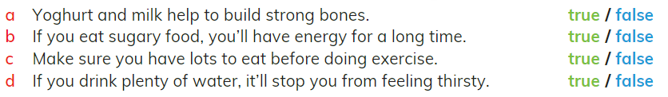
With your partner answer these questions.
WALT: Understand, with support, most of the main points of short and extended text.

Slide 6
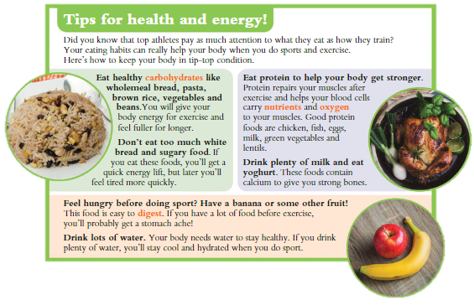
WALT: Understand, with support, most of the main points of short and extended text.
Read the text by yourself.
Finished? Think!
How healthy is your diet?
How could you make it healthier?
Page 30

Slide 7
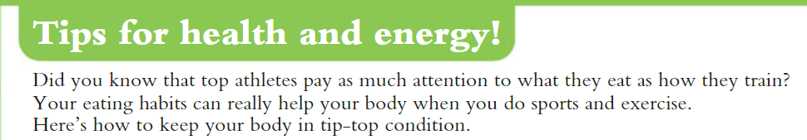
WALT: Understand, with support, most of the main points of short and extended text.
Let’s read together

Slide 8
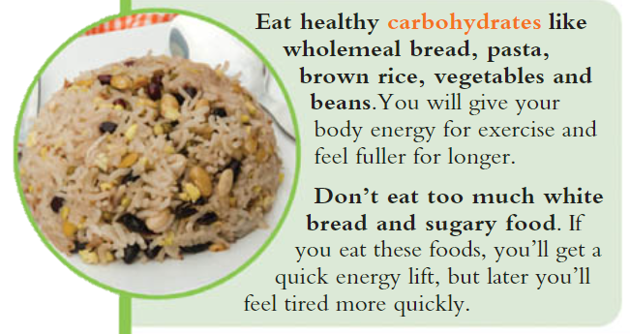
WALT: Understand, with support, most of the main points of short and extended text.
Let’s read together

Slide 9
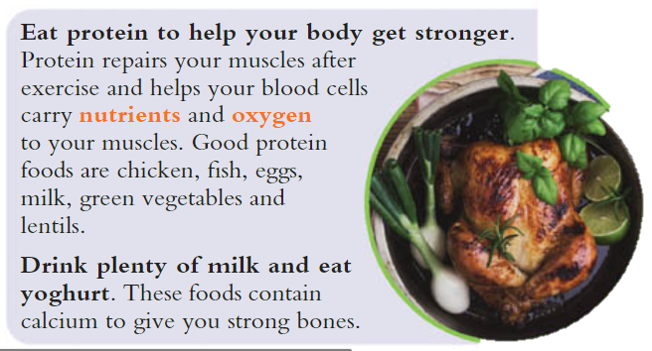
WALT: Understand, with support, most of the main points of short and extended text.
Let’s read together

Slide 10
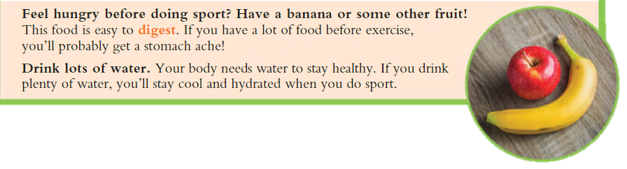
WALT: Understand, with support, most of the main points of short and extended text.
Let’s read together

Slide 11
WALT: Understand, with support, most of the main points of short and extended text.
Use the text to write your own healthy eating tips.
Modelling

Slide 12
WALT: Understand, with support, most of the main points of short and extended text.
With support, use the text to write your own healthy eating tips.
Independently, use the text to write your own healthy eating tips.
Use your prior knowledge to write your own healthy eating tips.

Slide 13
WALT: Understand, with support, most of the main points of short and extended text.
With support, I can use the text to write healthy eating tips.
Independently, I can use the text to write healthy eating tips.
I can use prior knowledge to write healthy eating tips.

Slide 14
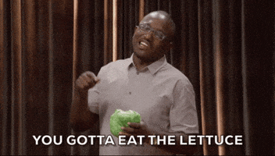
Plenary – What did you learn this lesson?
WALT: Understand, with support, most of the main points of short and extended text.
Did you learn any new healthy eating tips?
Which tips did you already know?

